Slide 1
Intro to Packet Analysis
Leander Metcalf
30 August 2015

Slide 2
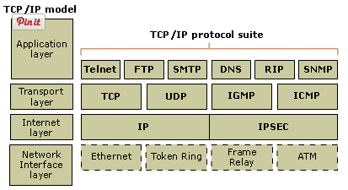
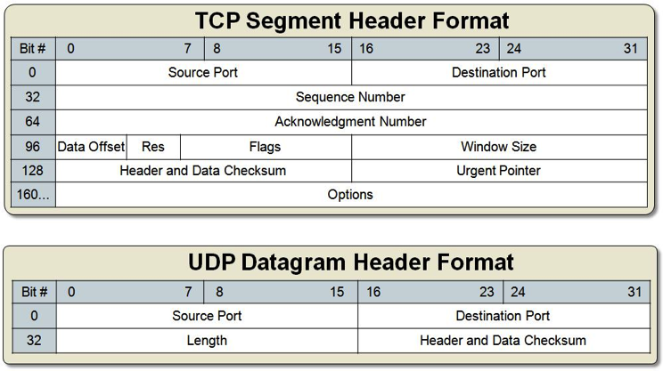
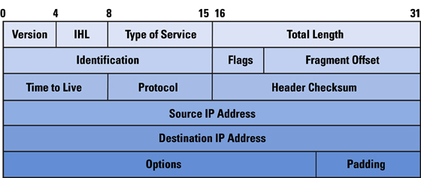
What is a packet?
Home Computer
Router
Web Server
Switch
Switch
Internet
Data Link
Physical
101010011000
101010011000
101010011000
101010011000
Application
Header
Data
Network layer may also be called the Internet layer.
Transport
Header
Data
Internet
Header
Data
Data Link
Header
Data
Physical
Header
Data
Physical
Footer
http://tinyurl.com/nqbrbvg
The Data Link layer and Physical layer are usually combined in the TCP/IP model.
Shown are the IP header for the Internet or Network layer and the TCP/UDP header formats for the transport layer
Notice that the port is never seen during the routing process “mid-hop”
http://tinyurl.com/o2n5rkc
http://tinyurl.com/nzvzfqe
Notes:
Image taken from TCP/IP Protocol Suite

Slide 3
Where do I start?
Any hints from the organizers in the challenge description? -> if so filter based on the hint
Charactertize the pcap -> Types of frames (UDP/TCP), ports used, number of hosts, types of requests (HTTP, FTP, SSL, etc.)
  Statistics -> Conversations
  Statistics -> Endpoints
  File -> Export Objects -> HTTP, SMB, etc.
Run strings on the pcap and look for common encryption/encoding schemes (xor, base64, WEP IVs, etc.)
Has any data been transferred?
What sites have been visited?

Slide 4
PA050 Walk Through
Characterize the PCAP
  It’s pretty small (156 packets)
  Statistics -> Conversations -> Checkout TCP & UDP
    Port 8008 looks interesting
    Couple of different website hits
  Three attempts to find a C&C (Follow the TCP Stream from the initial SYN/ACK) – this is the part of the attack that gets the kernel version
    Examine the stream of the successful connection
    Get the useful data out of it
    Write a small script to XOR stuff
    Win!
Demo Time!

Slide 5
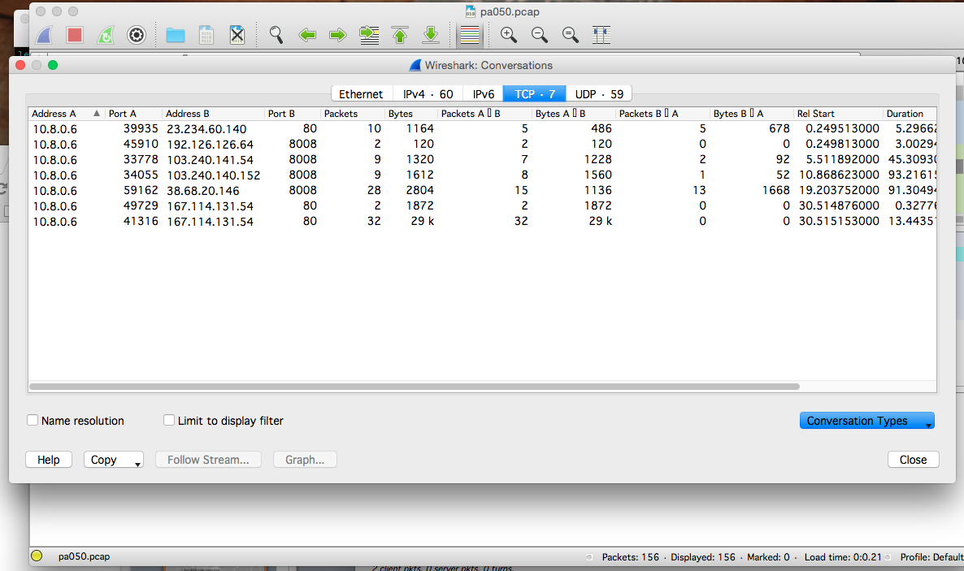
Wireshark Analysis

Slide 6
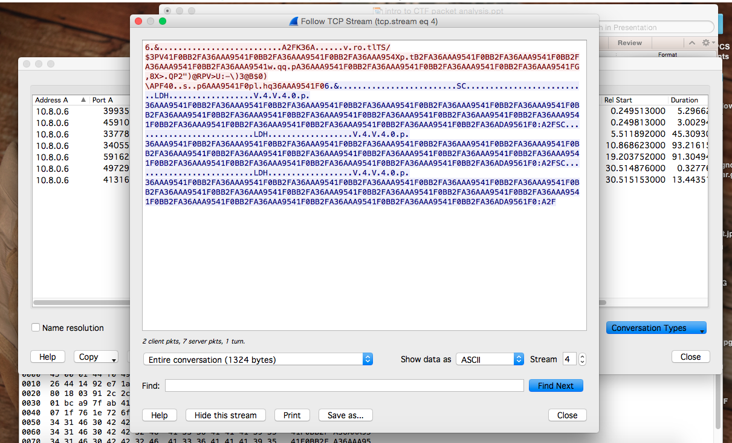
Finding the Useful Packet

Slide 7
Resources
PCAP Tool List @ https://github.com/caesar0301/awesome-pcaptools
CTF Field Guide @ https://trailofbits.github.io/ctf/
Pre-reading material for this presentation located under the pcap challenges @ https://github.com/MCPA/Team-Challenges
Must have PCAP Analysis Tools:
  Network Miner
  Explico
  Wireshark
  XOR and RSA Tool

